Slide 1
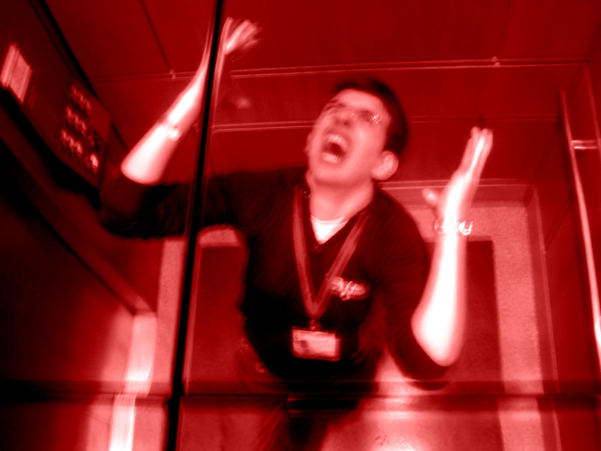
Elevator Pitch Workshop
Marketing yourself in the professional world

Slide 2
Contents
What is an elevator pitch?
What’s in a good pitch?
Examples
How to construct a pitch
Build your own
Critique others

Slide 3
What is an elevator pitch?
Purpose
Summarize aptitude and interest towards a particular job
Answers the question “Tell me about yourself”
Guidelines
Length: 30 to 60 seconds
Summarize 2 to 3 important “takeaways”

Slide 4
What’s in a good pitch?
Narrative
The story your experiences tell
What are the key experiences that define you?
How do they effect you?
Takeaways
What do you want me to remember from this interview?
What differentiates you?

Slide 5
Example 1: Billy Mays
http://www.youtube.com/watch?v=JpqiyFPdHZ4

Slide 6
Example 1: Kitchen
Strengths
Weaknesses
Very well spoken and enthusiastic
Has a clear objective and focus that builds a clear perspective
Summarizes takeaways
Over the top?
Credibility?
“Infomercial”
I can’t see myself working with this guy…

Slide 7
Example 2: Student
http://www.youtube.com/watch?v=OwEj3g-8R8c

Slide 8
Example 2: the Engineer
Strengths
Weaknesses
Tells a good story
Identifies interests and personal strengths
Outlines why he thinks he is a good fit and apply to consulting firm
Way to long about background
Don’t need all those details for it to be a good story
Differentiation
What makes him different then other economics majors?

Slide 9
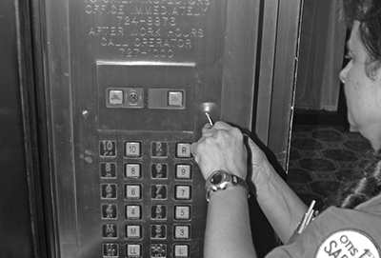
How to Build an Elevator

Slide 10
How to build an Elevator Pitch
1
List experiences in any order
Try to connect experiences to build key themes
2
Decide on 2-3 key themes
Eliminate all other experiences
3
Draft a few paragraphs
Narrow down to appx. one paragraph
4
Time and condense until ~45s.
Add about 10s of intro: Greeting, Name, Major

Slide 11

Other Tools
Framing experience
Situation/Task
Action
Result
Strong Action Verbs
Developed
Analyzed
Communicated
Planned

Slide 12
Getting You Started: My Experiences
High School
Wrestling Team Captain
Camp Councilor
YMCA Volunteer
Student Council
Freshman Year
Rugby Team
ChemE 112
Spanish Classes
Sales Job
Sophomore Year
Risk Manager
SEBA treasurer
P&G intern
Junior Year
Cornell Consulting Group
House Manager
Process Control

Slide 13
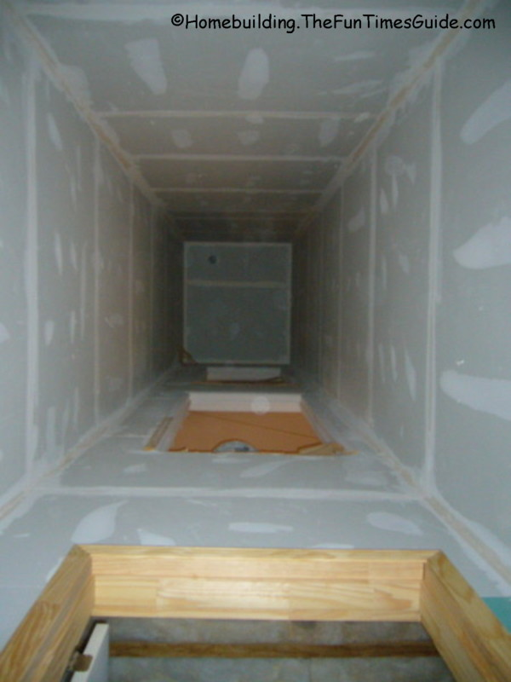
My Key Themes
Teamwork/Leadership
Wrestling Team Captain
ChemE 112
Cornell Consulting Group
House Manager
Technical Experience
Internship
Process Control

Slide 14
Getting You Started: My Experiences
High School
Tennis team captain
Eagle scout
Youth soccer volunteer coach
Freshman Year
General engineering requirements
Real estate research
Sophomore Year
SEBA marketing chair
Citi Intern
Junior Year
OR courses
SEBA president

Slide 15
My Key Themes
OR/Problem Solving
Study Operations Research
Technical problem solving
Interned at Citi
Built a tool for new system
Other interests
SEBA
Sports

Slide 16
My name is William Sanders. I am a Junior here at Cornell studying operations research and engineering. I have always been a curious person striving for the best answer or more information and operations research fits these interests perfectly. At school my classes teach various methods to solve problems to ultimately make better decisions. This past summer I had the opportunity to work at Citi in their franchise risk architecture and build a tool to impose structure and consistency to a data set enabling global business users to avoid data entry errors at the point of entry.
Custom closing line depending on the situation.

Slide 17
Do it Yourself:
1
List experiences in any order
Try to connect experiences to build key themes
2
Decide on 2-3 key themes
Eliminate all other experiences
3
Draft a few paragraphs
Narrow down to appx. one paragraph
4
Time and condense until ~45s.
Add about 10s of intro: Greeting, Name, Major

